Slide 1
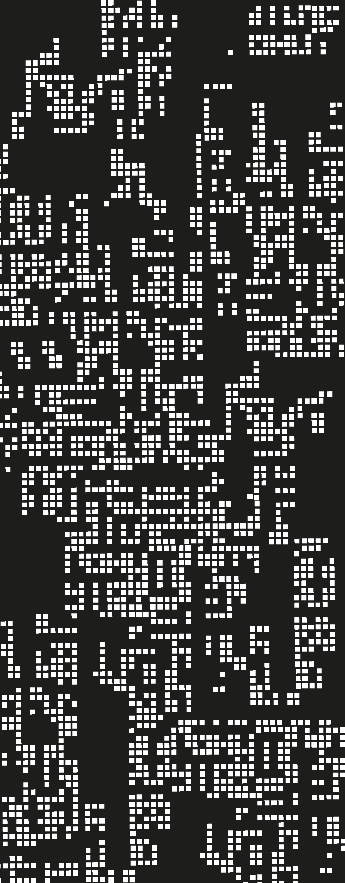
Recursion
Basic Concepts

Slide 2
Agenda
01
Watch out for the environment!
02
Basic Implementation

Slide 3
Can we use recursion?

Slide 4
Can we use recursion?
We did, on F1WAE because all functions were public and we knew about their existence. However, now we are on FAE so:
Do all functions have a name?
When does the environment know about the existence of a function?
(with (sum (fun (x)
(if-tf (zero?? n)
0
(+ n (sum (- n 1)))
)))
(sum 13))

Slide 5
Can we use recursion?
So, we have a problem on the environment. What is going on with this function?
x
(with (sum (fun (x)
(if-tf (zero?? n)
0
(+ n (sum (- n 1)))
)))
(sum 13))
named expression
Bien, cuál es el environment de named expression?
body

Slide 6
Can we use recursion?
So, we have a problem on the environment. What is going on with this function?
x
(with (sum (fun (x)
(if-tf (zero?? n)
0
(+ n (sum (- n 1)))
)))
(sum 13))
named expression
body
env = [sum -> (closureV …)]

Slide 7
Can we use recursion?
So, we have a problem on the environment. What is going on with this function?
x
env = [ ]
(with (sum (fun (x)
(if-tf (zero?? n)
0
(+ n (sum (- n 1)))
)))
(sum 13))
named expression
(closureV n …) (n -> 1)
body
env = [sum -> (closureV ‘n (if-tf ..) empty]

Slide 8
Can we use recursion?
So, we might need sum in the environment. But how can that be possible? If sum is not declared yet, how can we add it on the environment?
x
env = [ ]
(with (sum (fun (x)
(if-tf (zero?? n)
0
(+ n (sum (- n 1)))
)))
(sum 13))
named expression
(closureV n …) (n -> 1)
body
env = [sum -> (closureV n (if-tf …) (sum -> closureV n (if-tf …) (sum -> closureV….))]

Slide 9
Can we use recursion?
We seem to need an infinite number of sum adds on the environments. Our issue is with the environment. Lo que llamaremos el punto fijo de la recursividad.
x
env = [ ]
(with (sum (fun (x)
(if-tf (zero?? n)
0
(+ n (sum (- n 1)))
)))
(sum 13))
named expression
(closureV n …) (n -> 1)
body
env = [sum -> (closureV n (if-tf …) ( )]

Slide 10
Dealing with environments
envR = [sum -> (closureV n (if-tf …) ( )]
El ambiente recursivo captura la clausura y es el ambiente en el que evaluamos el cuerpo (pista, no usaremos with, necesitamos algo más poderoso)
sum
ClosureV
En Scheme, algo similar ocurre con let y letrec
n → 10
n → 9
n → 8

Slide 11
How to create a recursive environment?
So, let’s abstract the weird stuff we had on the previous slide
env init
closureV
N
(if-tf …)
[env]
sum

Slide 12

How to create a recursive environment?
Want me to make it more simple?

Slide 13
How to create a recursive environment?
So, how do we usually solve it? Let’s look at OOP
A = new A( new B (...))
Alternatives?

Slide 14
How to create a recursive environment?
So, how do we usually solve it? Let’s look at OOP
A = new A( new B (...))
Some languages already have ways of initializing mutually dependant objects

Slide 15
How to create a recursive environment?
So, how do we usually solve it? Let’s look at OOP
A = new A( new B (...))
Use null value
a = new A (null)
b = new B (a)
a.setB(b) ← Mutation!
So, chicken and egg situation is simple to solve in a world with mutation
E. Tanter

Slide 16
How to apply this logic?
We will use these same three phases.
sum
(incomplete-env)
Associate function with an incomplete environment.
(interp ne (incomplete-env))
Mutate and put the right reference.
We end up with a cyclic environment
sum
(incomplete-env)
(closureV n (if …))
sum
(incomplete-env)
(closureV n (if …) )

Slide 17
Summary
References
La recursión requiere de un ambiente cíclico, la forma más directa de ello es usar mutación.
PLAI, Chapter 9.

